Slide 1
Sales Performance Analysis of Walmart Stores Using Advanced MySQL Techniques
Sales Performance Analysis of Walmart Stores Using Advanced MySQL Techniques
SQL PROJECT
NAME - SURAJ DHONDIYAL BATCH - 1ST NOVEMBER
Analyzing Sales, Customer Behavior, and Product Trends

Slide 2
Introduction
Hello everyone! Today, I’m going to present my project on Sales Performance Analysis of Walmart Stores Using Advanced MySQL Techniques. Walmart is one of the largest retail chains in the world, and they have stores in many cities selling a wide range of products like electronics, fashion, groceries, and more.
In this project, I analyzed Walmart’s sales data to help them understand their sales performance, customer behavior, and product trends. I used MySQL, which is a database management tool, to write queries and extract useful insights from the data.

Slide 3
The dataset I worked with includes information about -
Sales transactions (like what was sold, when, and for how much).
Customer details (like gender, customer type, and payment methods).
Product information (like product lines and costs).
The goal of this project is to help Walmart make better business decisions by answering important questions like:
Which branch is performing the best?
Which products are most profitable?
Who are the most valuable customers?

Slide 4
Task 1: Identifying the Top Branch by Sales Growth Rate..
The first task was to identify the top branch by sales growth rate. Walmart wanted to know which branch is growing the fastest in terms of sales.
To do this -
Calculated the total sales for each branch every month.
Compared the sales from one month to the next to find the growth rate.
Identified the branch with the highest average growth rate.
Task 1: Identifying the Top Branch by Sales Growth Rate

Slide 5
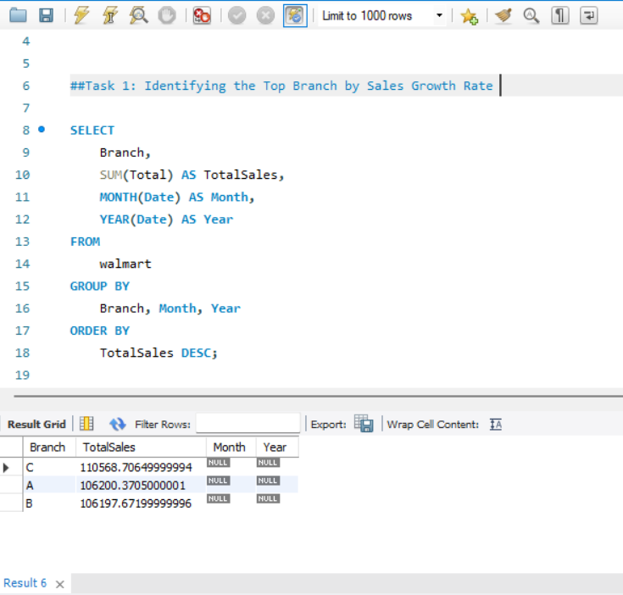
Explanation
This query calculates the total sales for each branch by month and year. It groups the data by Branch, Month, and Year, then sorts the results in descending order of total sales. The branch with the highest sales growth will appear at the top.

Slide 6
SQL query I used:
SELECT
Branch,
SUM(Total) AS Totalsales,
MONTH(Date) AS Month,
YEAR(Date) AS Year
FROM
walmart
GROUP BY
Branch, Month, Year
ORDER BY
TotalSales DESC;

Slide 7
Task 2: Finding the Most Profitable Product Line for Each Branch…
here, I analyzed which product line is the most profitable for each branch. Walmart wanted to know which products (like electronics, fashion, or groceries) bring in the most profit.
To do this –
Calculate the profit for each product line in each branch.
Identify the most profitable product line by summing up the profit for each.

Slide 8
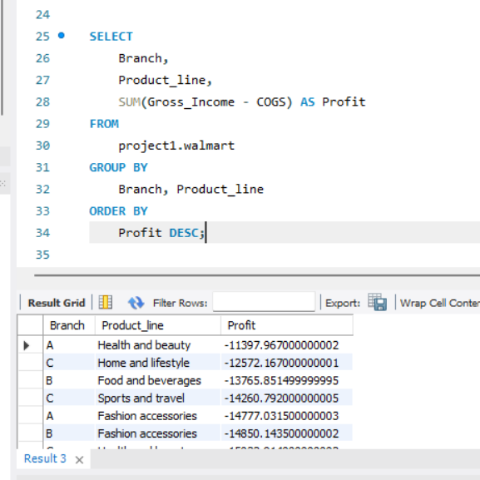
SQL query I used:
1. We are calculating the profit for each product line using the formula : cross_income – COGS.
2. then we group the data by branch and product_line and order the result to identify which product line has the highest profit for each branch.

Slide 9
Task 3: Analyzing Customer Segmentation Based on Spending…
In this task, I segmented customers based on their spending behavior. Walmart wanted to know who their high spenders, medium spenders, and low spenders are.
To do this –
Calculated the total amount each customer spent.
classify customers into categories based on their total spending .

Slide 10
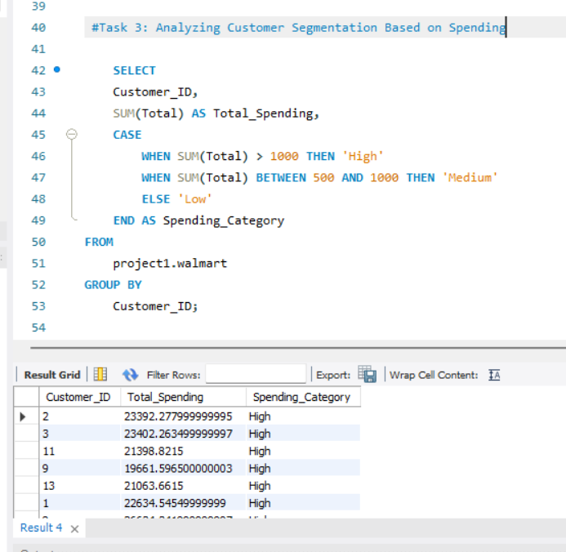
SQL query I used

Slide 11
Task 4: Detecting Anomalies in Sales Transactions
jjfjfjf
We calculate the total spending for each customer by summing their total purchases.
We then classify them using a case statement.
High spenders if total spending is greater than 1000,
Medium spenders if the spending is between 500 and 1000,
Low spenders if spending is less than 500.
Walmart wanted to know if there were any unusual transactions in their sales data. For example, some transactions might be too high or too low compared to the average.
To do this -
Calculated the average sales for each product line.
Flagged transactions that were much higher or lower than the average.

Slide 12
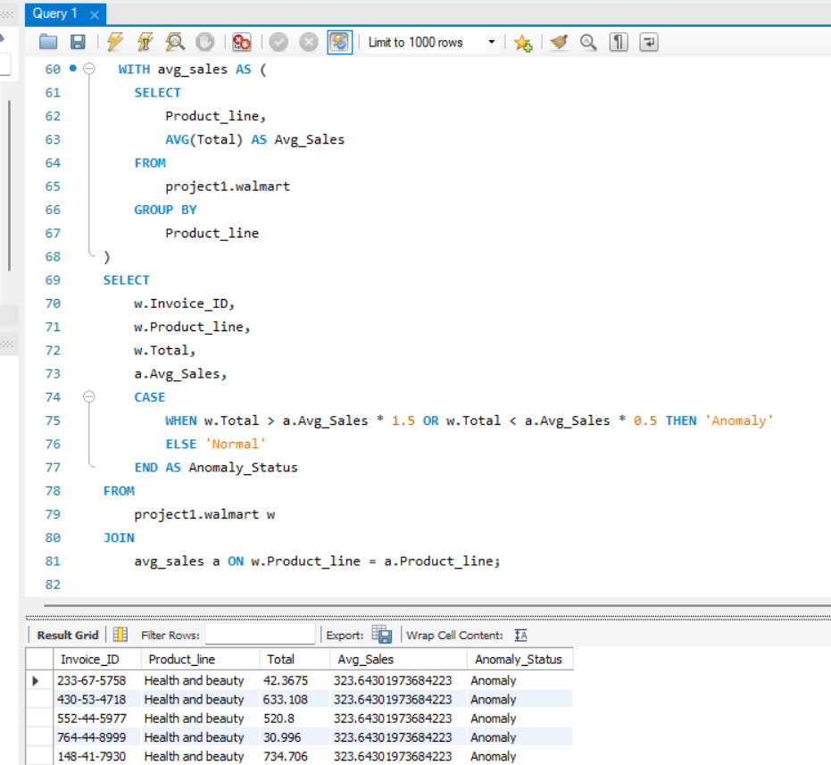
SQL query I used

Slide 13
Task 5 - Most Popular Payment Method by City
First we calculate the average sales for each product line.
then we flag transactions as anomalies if the sales are greater then 1.5 times the average or less then 0.5 times the average, indicating unusually high or low sales.
Walmart wanted to know which payment method (like cash, credit card, or mobile payments) is most popular in each city.
To do this -
Counted how many times each payment method was used in each city.
Identified the most popular payment method for each city.

Slide 14
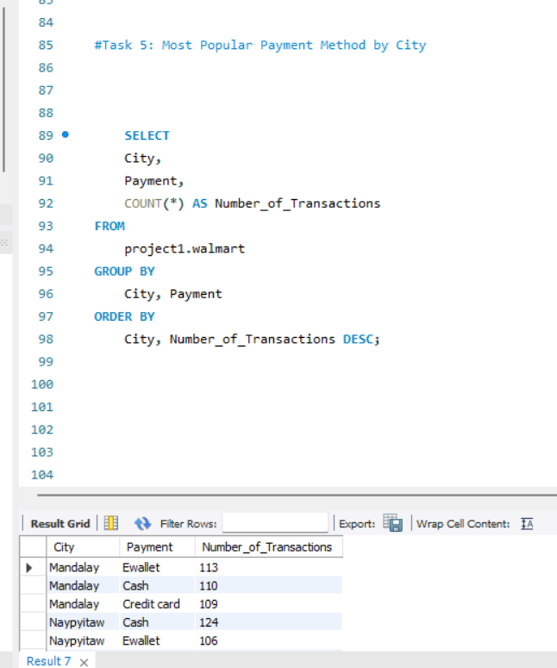
SQL query I used
Explanation :
1.We count the number of transactions for each payment method and city combination.
2. The result is ordered by the number of transactions to find the most popular payment method in each city .

Slide 15
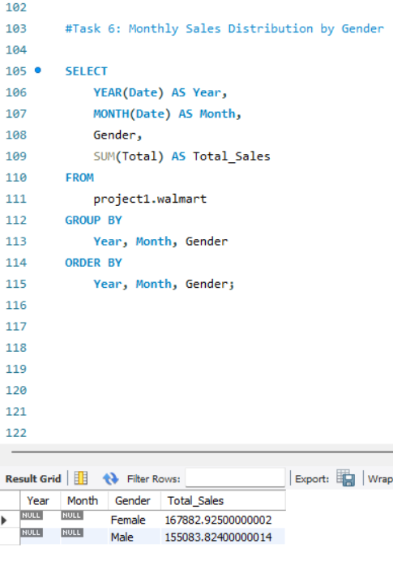
Task 6 - Monthly Sales Distribution by Gender
Walmart wanted to understand how sales are distributed between male and female customers each month.
To do this -
Calculated the total sales for each month, grouped by gender.
SQL query I used
I grouped the date by gender and year-month using year(date) and month(date).
I sum the total sales for each combination of gender and month.
The result shows how the sales distribution between male and female customers changes on a monthly basis.

Slide 16
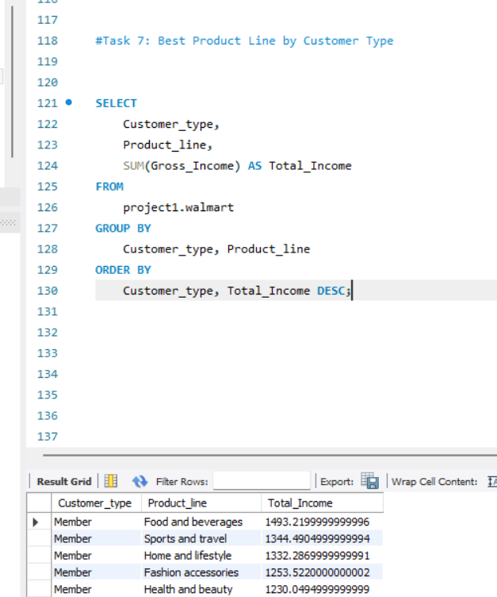
Task 7 - Best Product Line by Customer Type
Walmart wanted to know which product lines are preferred by Members vs. Normal Customers.
To do this -
Calculated the total sales for each product line, grouped by customer type.
SQL query I used
I group by customer_type and product_line.
I sum the gross_income for each combination of customer type and product line.
This helps identify the most profitable product line for each type of customer(member vs normal).

Slide 17
Walmart wanted to identify customers who made repeat purchases within 30 days.
To do this -
Compared the dates of each customer’s purchases.
Identified customers who shopped again within 30 days.
Task 8 - Identifying Repeat Customers
SQL query I used

Slide 18
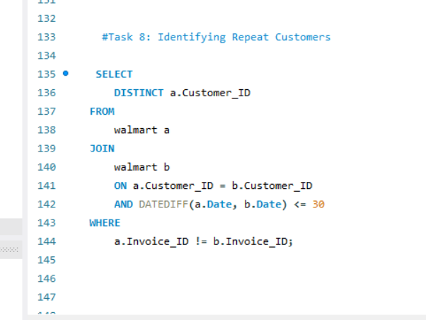
Explanation
We join the Walmart table with itself (a and b) to compare the transactions of the same customer.
The DATEDIFF(a.Date,b.Date) <=30 condition checks if the transactions were made within 30 days of each other.

Slide 19
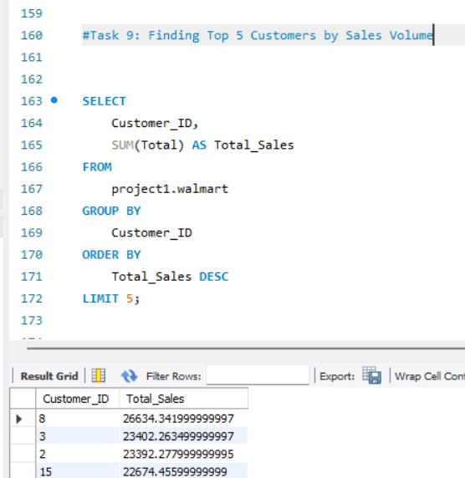
Task 9 - Top 5 Customers by Sales Volume
Walmart wanted to reward their top 5 customers who generated the most sales.
To do this -
Calculated the total sales for each customer.
Ranked them and picked the top 5.
SQL query I used
i group the data by customer id and sum the total sales for each customer.
The result is sorted by total_sales in descending order and the limit 5 ensures we only get the top 5 customer by sales .

Slide 20
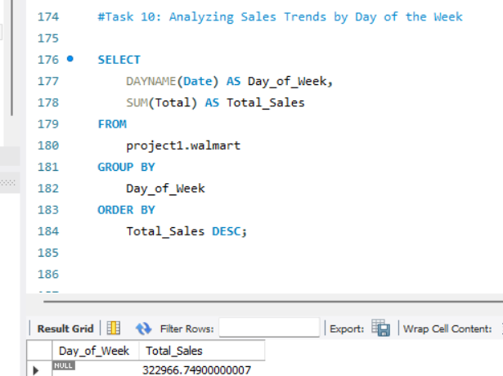
Task 10 - Sales Trends by Day of the Week
Walmart wanted to know which day of the week has the highest sales.
To do this-
Calculated the total sales for each day of the week.
SQL query I used
I use the DAYNAME() function to extract the day of the week from the date column.
We then group by the day of the week and sum the total sales for each day.
The result the highest sales.

Slide 21
Conclusion
In this project, I analyzed Walmart’s sales data using advanced MySQL techniques. Here are the key findings –
Branch A is growing the fastest.
Electronics is the most profitable product line.
Saturday is the best day for sales.
These insights can help Walmart optimize their sales strategies, improve customer satisfaction, and grow their business.
Thank You!

